Slide 1


Aundre Senarathna
12/03/2023

Slide 2

Outline
Executive Summary
Introduction
Methodology
Results
Conclusion
Appendix

Slide 3
Executive Summary
Summary of methodologies:
Data was gathered from multiple sources, such as APIs and via web scraping, next the data was preprocessed to conduct EDA, visualize and predict whether the Falcon 9 first stage would land successfully using classification ML models such as Logistic Regression, SVM, KNN and decision trees
Summary of all results
Launch site success rates: CCAFS LC-40, has a success rate of 60 %, while KSC LC-39A and VAFB SLC 4E has a success rate of 77%.
for the VAFB-SLC launchsite there are no rockets launched for heavypayload mass(greater than 10000)
LEO orbit the Success appears related to the number of flights; on the other hand, there seems to be no relationship between flight number when in GTO orbit.
Success rate since 2013 kept increasing till 2017 (stable in 2014) and after 2015 it started increasing.
Logistic regression had a test accuracy of 83% in predicting whether the Falcon 9 first stage would land successfully

Slide 4
Introduction
SpaceX's Falcon 9 rocket revolutionized space travel by incorporating reusable first stages, drastically reducing launch costs. The ability to predict the success of the first stage landing is pivotal in determining the overall launch cost and competitiveness in the market.
Objective: Develop a predictive model to determine if the Falcon 9 first stage will land successfully.
Problems you want to find answers:
Cost Efficiency: The cost of a launch is significantly influenced by the successful recovery of the first stage. Predicting landing outcomes allows for accurate cost estimations, providing a competitive edge in the industry.
Market Competition: In a landscape where other providers incur higher launch costs, predicting landing success becomes a strategic advantage. Alternate companies can use this information to optimize bids against SpaceX for rocket launches.
Data-driven Decision Making: Leveraging data science methodologies, we aim to analyze Falcon 9 landing data, create insightful visualizations, and build machine learning models to enhance business decision-making processes.

Slide 5

Section 1

Slide 6
Methodology
Executive Summary
Data collection methodology:
Data was collected using RESTful API and Web Scraping and then data was converted to data frames using the pandas library
Perform data wrangling
Identified and handled missing or inconsistent data points to ensure data integrity and organized the dataset for coherence, streamlining it for subsequent analyses.
Perform exploratory data analysis (EDA) using visualization and SQL
Perform interactive visual analytics using Folium and Plotly Dash
Perform predictive analysis using classification models
Data Splitting into training and testing sets, training the models, carrying out hyperparameter tuning and model evaluation

Slide 7
Data Collection
Identify Data Source:
Define the target data related to Falcon 9 first-stage landings.
Identify relevant APIs and web sources providing this information.
API Integration:
Establish connections with the identified RESTful API.
Retrieve real-time and historical data on Falcon 9 launches.

Slide 8
Data Collection – SpaceX API
Present your data collection with SpaceX REST calls using key phrases and flowcharts
https://github.com/Aundre-Senarathna/IBM-Applied-Data-Science-Capstone/blob/main/jupyter-labs-spacex-data-collection-api.ipynb
Request and parse the SpaceX launch data using the GET request → Filter the dataframe to only include Falcon 9 launches →Dealing with Missing Values

Slide 9
Data Collection - Scraping
Present your web scraping process using key phrases and flowcharts
https://github.com/Aundre-Senarathna/IBM-Applied-Data-Science-Capstone/blob/main/jupyter-labs-webscraping.ipynb
Request the Falcon9 Launch Wiki page from its URL → Extract all column/variable names from the HTML table header → Create a data frame by parsing the launch HTML tables

Slide 10
Data Wrangling
Cleaning: Addressed missing values and removed duplicates. Ensured dataset accuracy by correcting inaccuracies.
Transformation: Standardized data types for consistency. Prepared variables for machine learning compatibility.
Feature Engineering: Created new features to enhance predictive power.
Outlier Handling: Identified and addressed outliers to prevent bias.
Data Splitting: Segregated data for effective machine learning training.
https://github.com/Aundre-Senarathna/IBM-Applied-Data-Science-Capstone/blob/main/labs-jupyter-spacex-Data%20wrangling.ipynb

Slide 11
EDA with Data Visualization
FlightNumber vs. PayloadMass: Predictive insights into successful landings.
Launch Site Analysis: Scatter plots revealing success patterns at each site.
Payload vs. Orbit: Identification of landing success patterns for different payloads.
Orbit Success Rate: Bar chart depicting success rates for each orbit type.
FlightNumber vs. Orbit Type: Scatter plots exploring flight number relationships in different orbits.
Payload vs. Orbit Type: Analysis of payload success rates in various orbits.
Yearly Success Trend: Line chart showcasing the average launch success trend over the years.
https://github.com/Aundre-Senarathna/IBM-Applied-Data-Science-Capstone/blob/main/jupyter-labs-eda-dataviz.ipynb

Slide 12
EDA with SQL
Display the names of unique launch sites in the space mission.
Display 5 records where launch sites begin with the string 'CCA'.
Display the total payload mass carried by boosters launched by NASA (CRS).
Display average payload mass carried by booster version F9 v1.1.
List the date when the first successful landing outcome in ground pad was achieved.
List the names of the boosters which have success in drone ship and have payload mass greater than 4000 but less than 6000.
List the total number of successful and failure mission outcomes.
List the names of the booster_versions which have carried the maximum payload mass. Use a subquery.
List the records which will display the month names, failure landing_outcomes in drone ship, booster versions, launch_site for the months in year 2015.
Rank the count of landing outcomes (such as Failure (drone ship) or Success (ground pad)) between the date 2010-06-04 and 2017-03-20, in descending order.
https://github.com/Aundre-Senarathna/IBM-Applied-Data-Science-Capstone/blob/main/jupyter-labs-eda-sql-coursera_sqllite.ipynb

Slide 13
Build an Interactive Map with Folium
Visualized the locations of all launch sites on the map, providing an overview of their geographical distribution.
Highlighted successful launches with green markers and failed launches with red markers, providing a quick visual representation of success rates at each launch site.
Explored the proximity of launch sites to various points of interest (coastline, city, railway, highway).
Calculated and displayed distances between launch sites and these points, allowing for analysis of spatial relationships.
https://github.com/Aundre-Senarathna/IBM-Applied-Data-Science-Capstone/blob/main/lab_jupyter_launch_site_location.ipynb

Slide 14
Build a Dashboard with Plotly Dash
Launch Site Dropdown:
Purpose: Select a launch site for focused analysis.
Interaction: Users can choose a specific launch site.
Success Pie Chart:
Purpose: Visualize launch outcomes distribution for the selected site.
Interaction: Dynamically updates based on the chosen launch site.
Payload Range Slider:
Purpose: Filter launches by payload mass ranges.
Interaction: Users can set payload mass filters.
Success-Payload Scatter Chart:
Purpose: Explore the relationship between payload mass and launch success.
Interaction: Updates based on launch site and payload mass range.Add the GitHub URL of your completed Plotly Dash lab, as an external reference and peer-review purpose
https://github.com/Aundre-Senarathna/IBM-Applied-Data-Science-Capstone/blob/main/spacex_dash_app.py

Slide 15
Predictive Analysis (Classification)
Data Splitting into training and testing sets, training the models using classification models such as logistic regression, Support Vector Machines (SVM), K Nearest Neighbor and Decision Trees carrying out hyperparameter tuning and model evaluation.
https://github.com/Aundre-Senarathna/IBM-Applied-Data-Science-Capstone/blob/main/SpaceX_Machine_Learning_Prediction_Part_5.jupyterlite.ipynb

Slide 16
Results
Exploratory data analysis results
Interactive analytics demo in screenshots
Predictive analysis results

Slide 17

Section 2

Slide 18
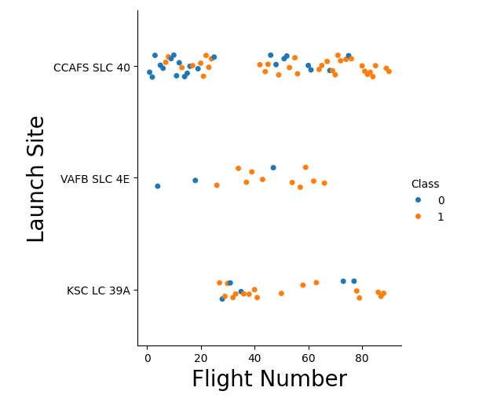
Flight Number vs. Launch Site
Launch Site VAFB SLC 4E seems to have a better success rate as flight numbers increase

Slide 19
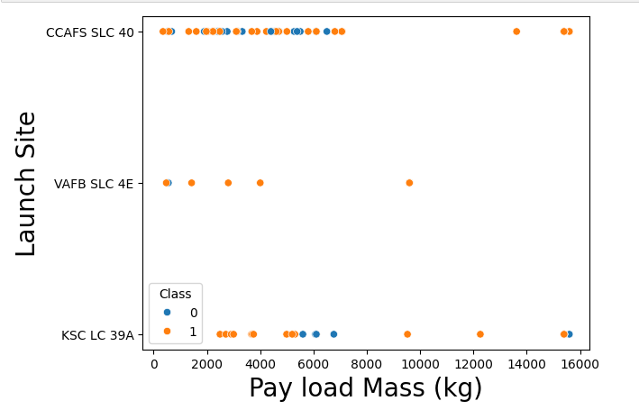
Payload vs. Launch Site
The VAFB-SLC launchsite there are no rockets launched for heavypayload mass(greater than 10000).

Slide 20
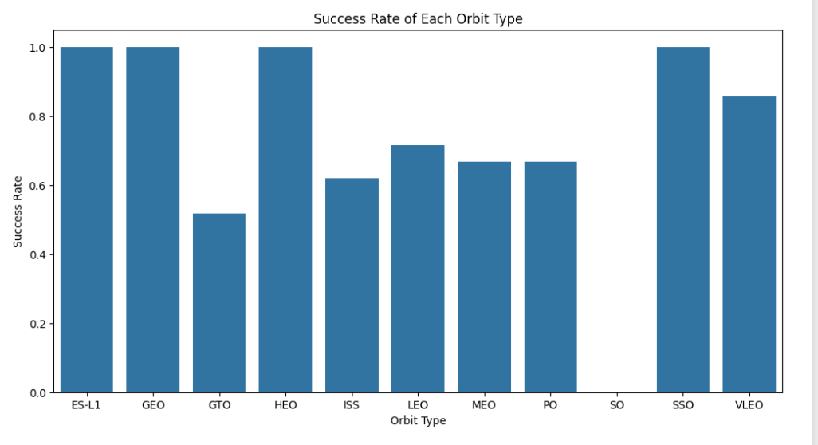
Success Rate vs. Orbit Type
ES-LI, GEO, HEO and SSO has success rate of 100%

Slide 21
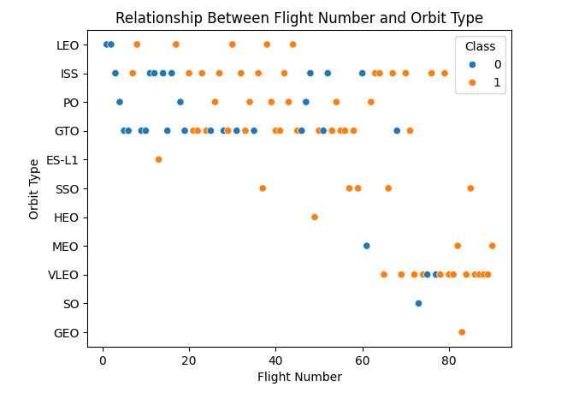
Flight Number vs. Orbit Type
LEO orbit the Success appears related to the number of flights; on the other hand, there seems to be no relationship between flight number when in GTO orbit.

Slide 22
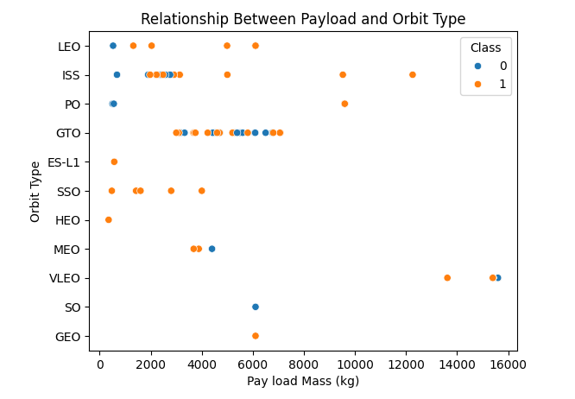
Payload vs. Orbit Type
With heavy payloads the successful landing or positive landing rate are more for Polar,LEO and ISS.
However for GTO we cannot distinguish this well as both positive landing rate and negative landing(unsuccessful mission) are both there here

Slide 23
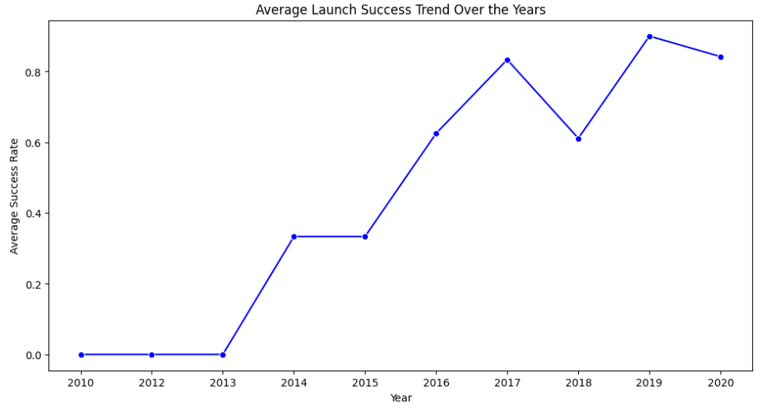
Launch Success Yearly Trend
The success rate since 2013 kept increasing till 2017 (stable in 2014) and after 2015 it started increasing.

Slide 24
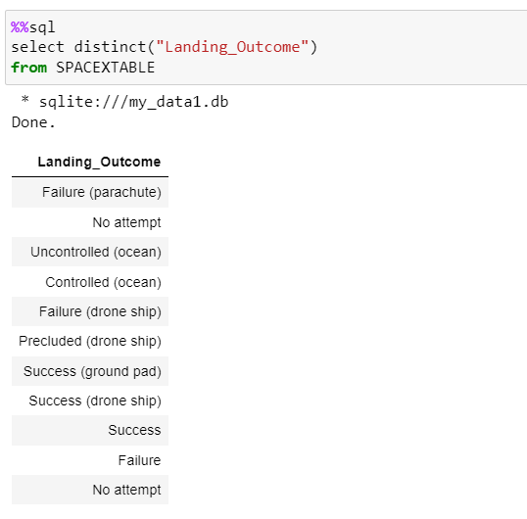
All Launch Site Names

Slide 25
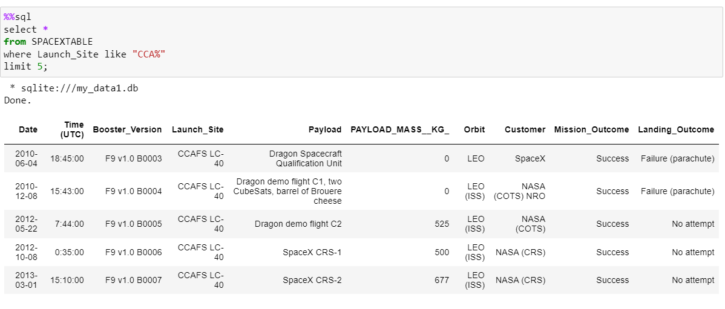
Launch Site Names Begin with 'CCA'

Slide 26
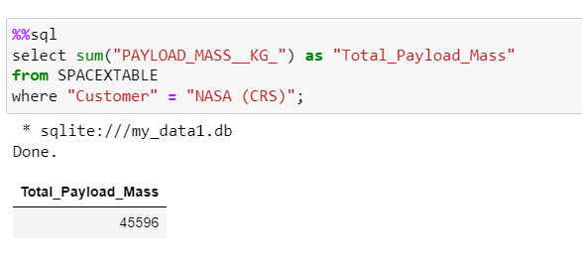
Total Payload Mass

Slide 27
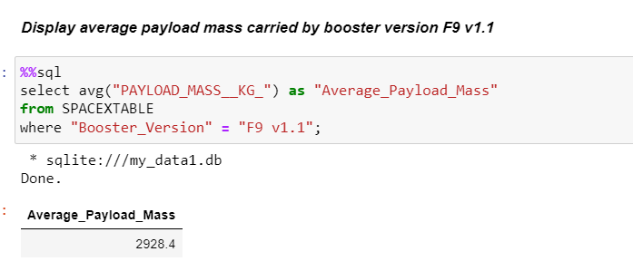
Average Payload Mass by F9 v1.1

Slide 28
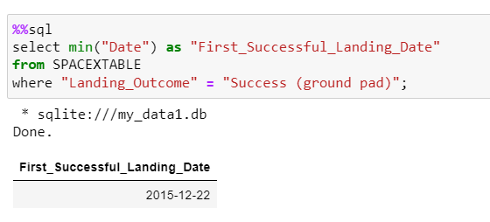
First Successful Ground Landing Date

Slide 29
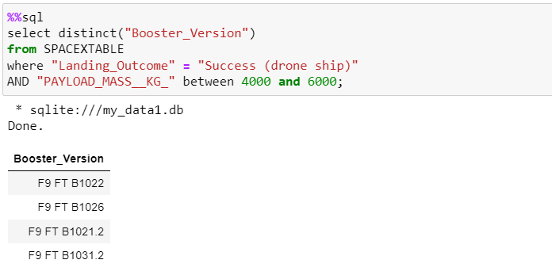
Successful Drone Ship Landing with Payload between 4000 and 6000

Slide 30
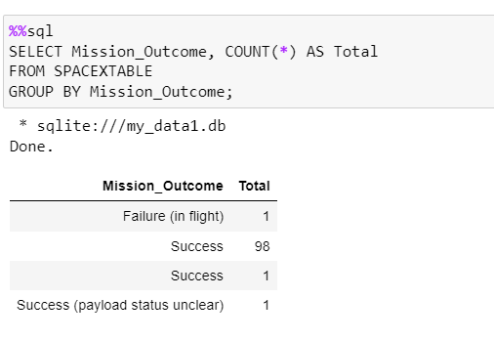
Total Number of Successful and Failure Mission Outcomes

Slide 31
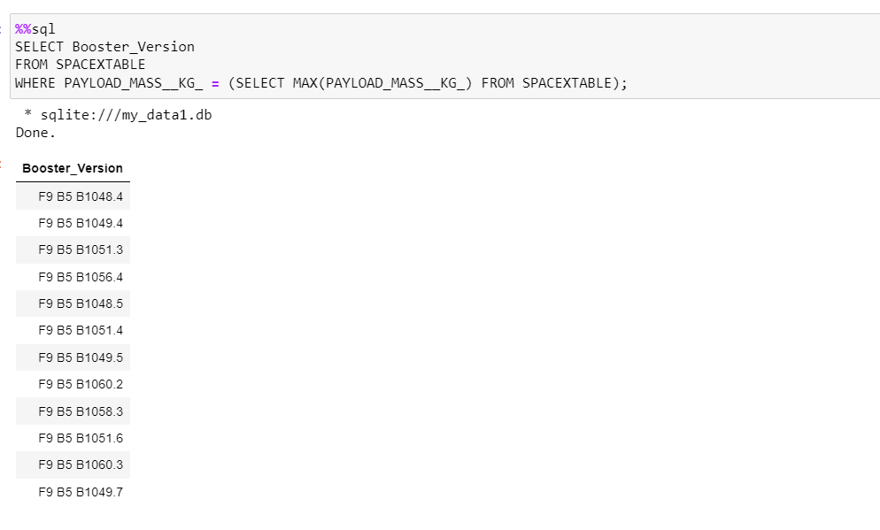
Boosters Carried Maximum Payload

Slide 32
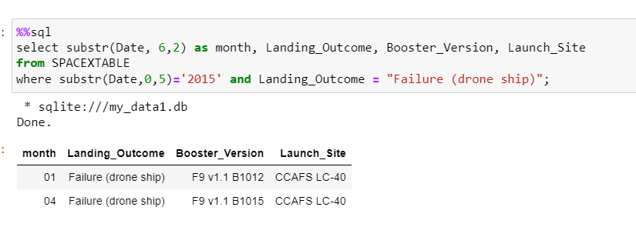
2015 Launch Records

Slide 33
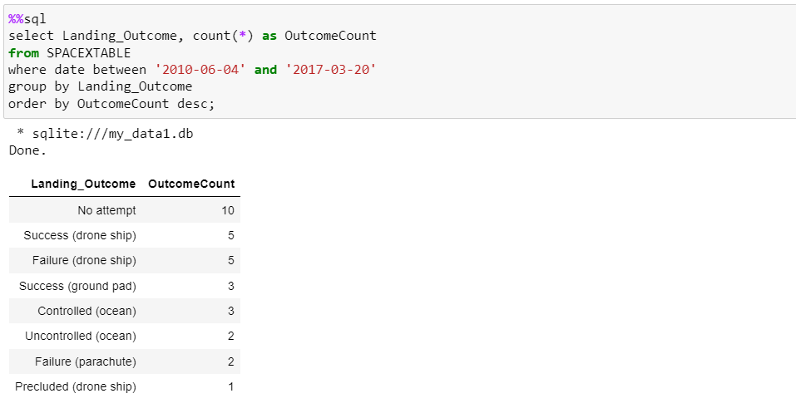
Rank Landing Outcomes Between 2010-06-04 and 2017-03-20

Slide 34

Section 3

Slide 35
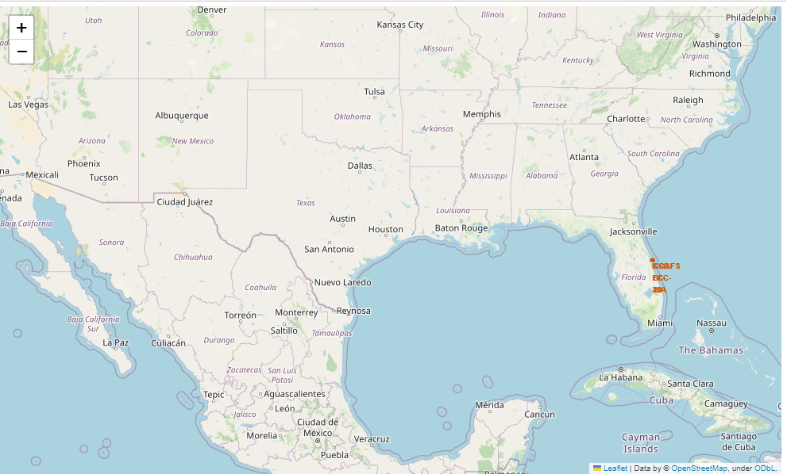
<Folium Map Screenshot 1>

Slide 36
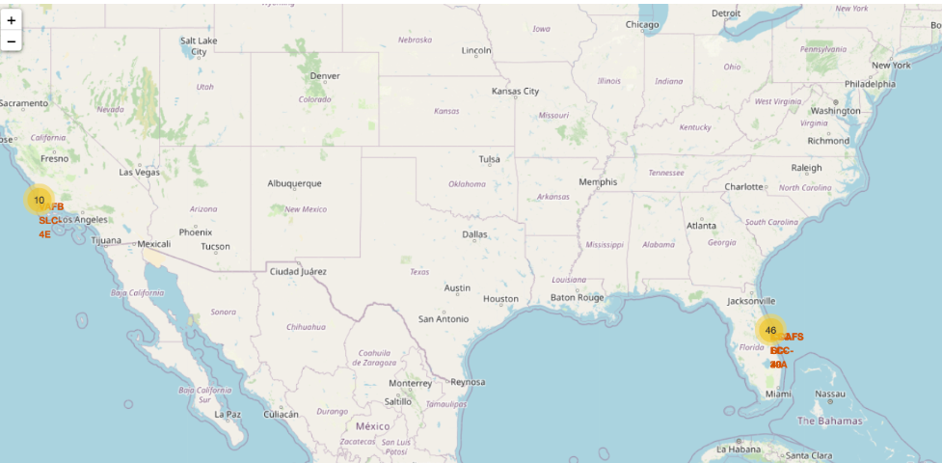
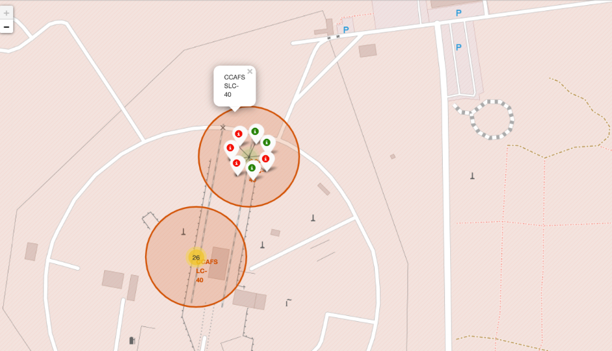
<Folium Map Screenshot 2>

Slide 37
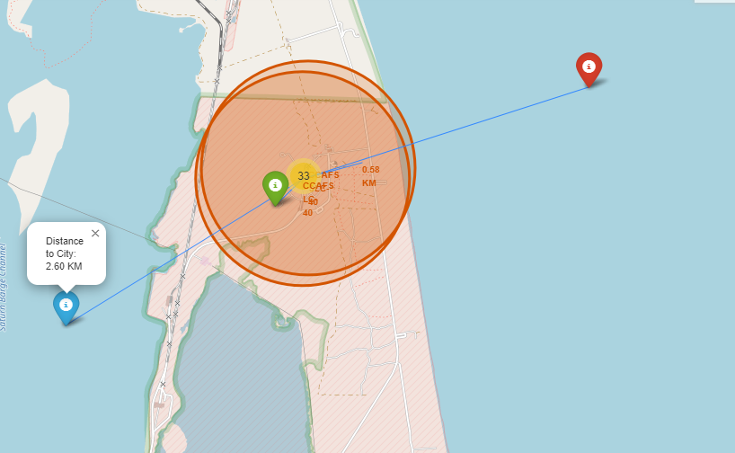
<Folium Map Screenshot 3>

Slide 38

Section 4

Slide 39
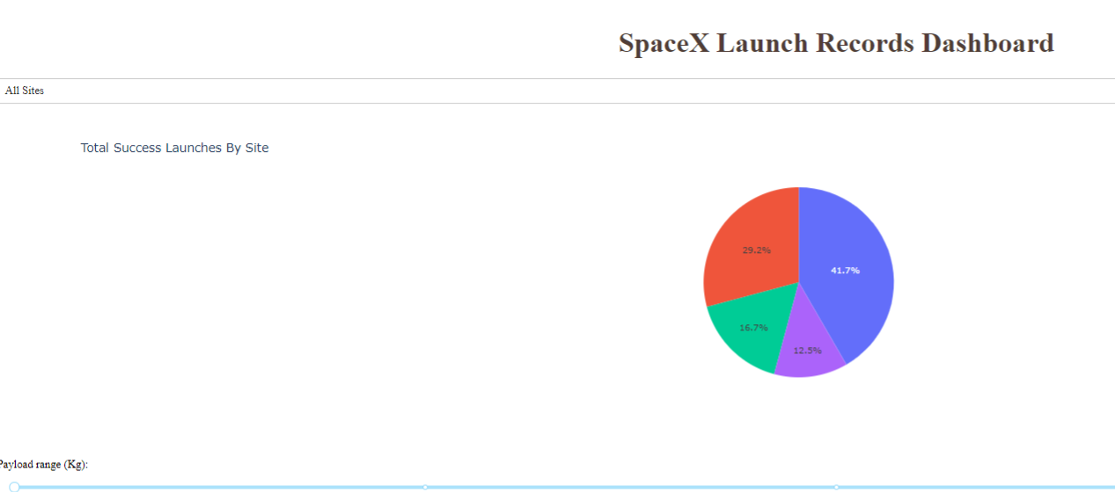
<Dashboard Screenshot 1>
launch success count for all sites

Slide 40
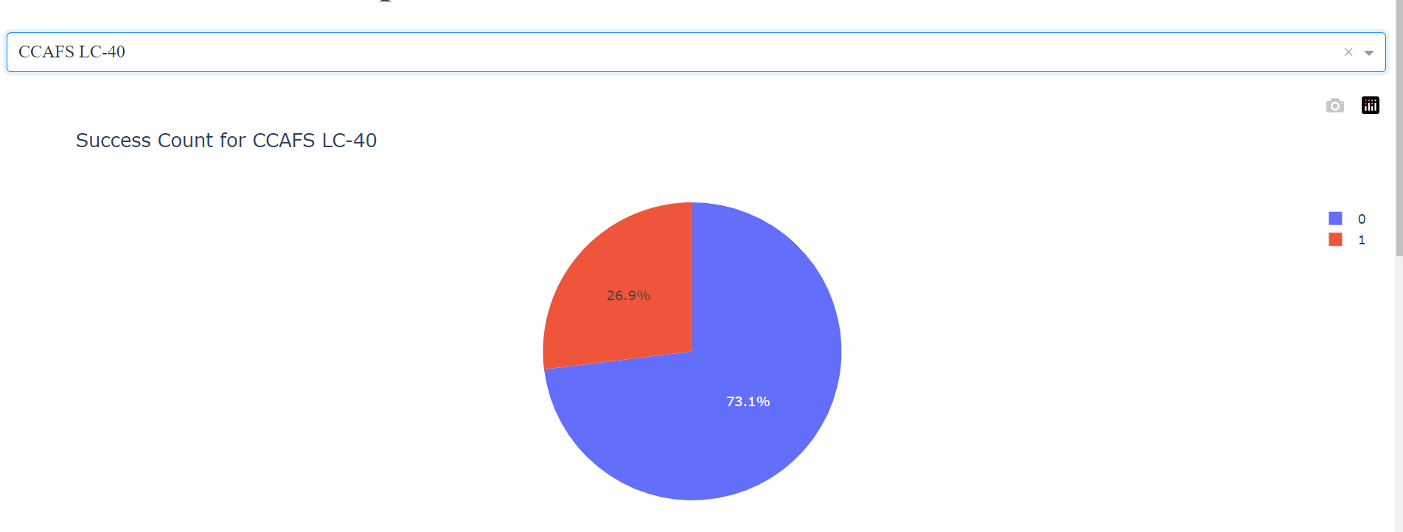
<Dashboard Screenshot 2>
Piechart for the launch site with highest launch success ratio

Slide 41
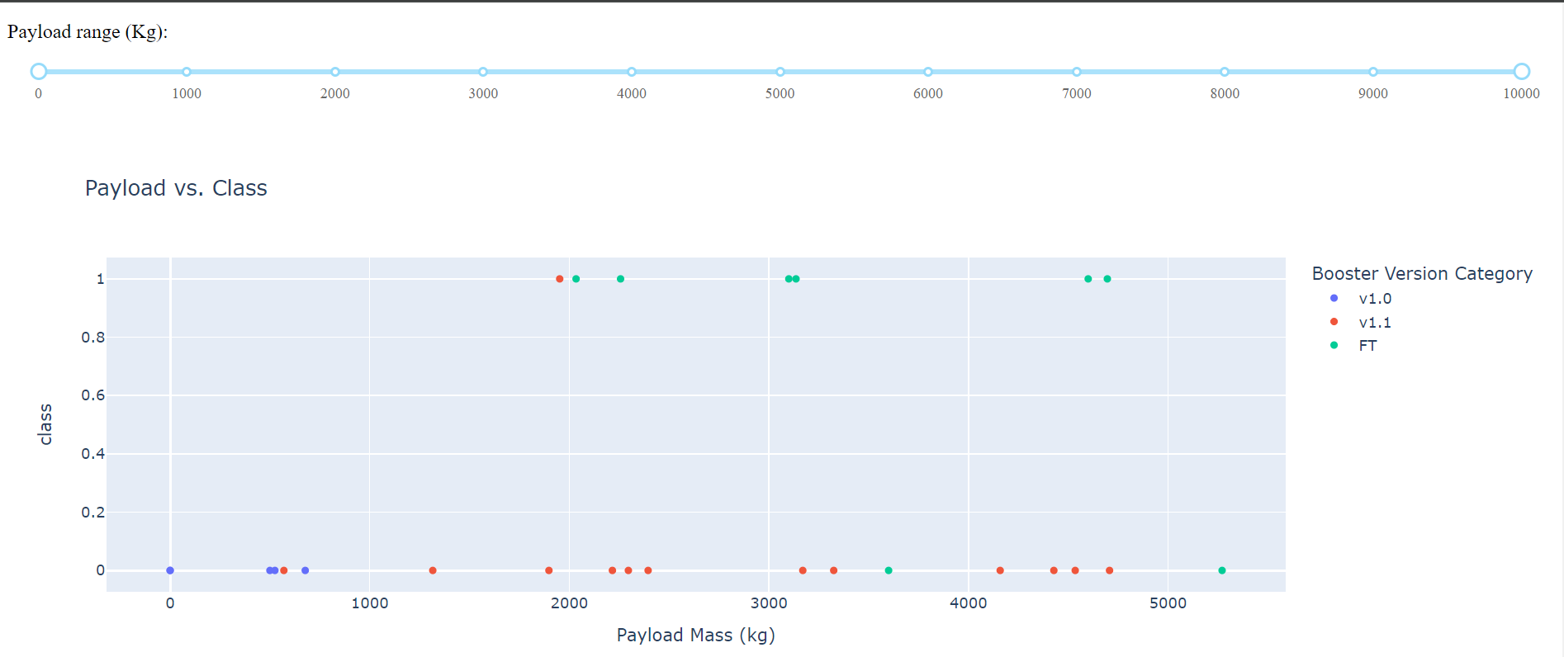
<Dashboard Screenshot 3>
Payload vs. Launch Outcome scatter plot for all sites

Slide 42

Section 5

Slide 43
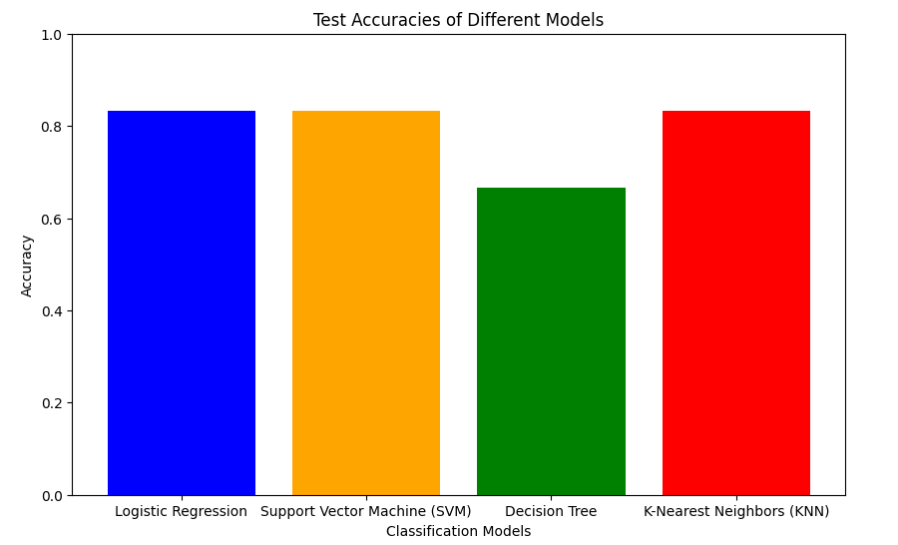
Classification Accuracy
Logistic regression seems to have the highest accuracy

Slide 44
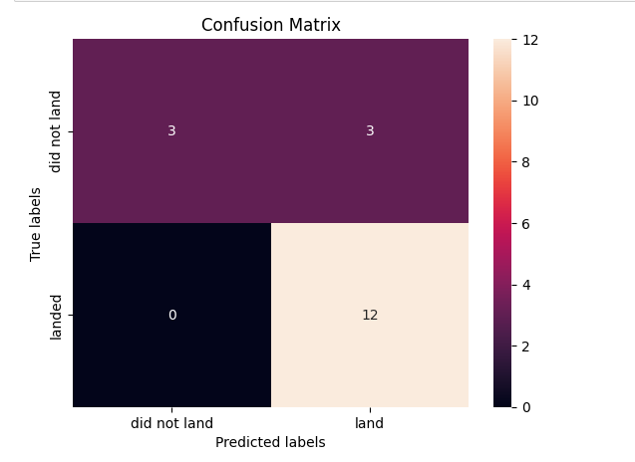
Confusion Matrix
Examining the confusion matrix, we see that logistic regression can distinguish between the different classes. We see that the major problem is false positives.

Slide 45
Conclusions
Cost Determination: Understand the potential cost of a Falcon 9 launch by predicting the success of the first-stage landing.
Competitive Bidding: Provide valuable insights for companies interested in bidding against SpaceX for rocket launches.
Data Exploration and Manipulation: Develop Python code to manipulate and analyze data, converting JSON files into Pandas data frames.
Exploratory Data Analysis (EDA): Apply data science methodologies to define and formulate real-world business problems, exploring data insights.
Machine Learning for Prediction: Utilize machine learning techniques to determine the success of the Falcon 9 first-stage landing.
Optimization Strategies: Optimize hyperparameters for Support Vector Machines (SVM), Classification Trees, and Logistic Regression to identify the most accurate predictive model.

Slide 46


